Slide 1

GOVERNMENT EDUCATION FUND DISTRIBUTION AND TRACKING SYSTEM USING BLOCKCHAIN TECHNOLOGY
Presented by
Lakshmi C(FIT20MCA-2070)
Roll no:12
MCA S4 B

Slide 2
CONTENTS
Introduction
Objective
Relevance
Existing system & Proposed System
Modules
Tools , Framework and Programming Language
Reference

Slide 3
INTRODUCTION
Governments need to cater to a huge number of responsibilities of a state. The working of state governments involves huge number of transactions towards various operations that need to be carried out throughout the state.
This includes new projects, repair and maintenance works, awarding contracts, paying of government employees, farmer schemes and so on.
A major obstacle that the top government face is the low level corruption that is sometimes not possible to track which deprives the state progress. Tracking it is a very complicated task due to the current system.
But in proposed system we overcome this drawbacks by using block chain approach.

Slide 4
OBJECTIVE
Usually when a project is allocated funds, there is no knowledge as to how these funds are being used and a large part of it is never show in records due to corruption. This project is focused on education fund distribution and tracking.
To solve this problem, a system has been proposed using Blockchain to provide the transparency.

Slide 5
RELAVENCE
The working of state governments involves huge number of transactions towards various operations that need to be carried out throughout the state.
So sometimes there is no clarity in the transactions. And also the issue of security is there . A hacker can hack the details.
Using block-chain technology to maintain the transparency & security at every stage as the funds move ahead.
This system allows us to maintain the crystal clear record with all users who are connected in the chain to transaction the data on a need to know basis.

Slide 6
EXISTING SYSTEM
The working of state governments involves huge number of transactions towards various operations that need to be carried out throughout the state. Different kinds of transactions are going on .
A major hurdle that the top government face is the low level corruption that is sometimes impossible to track which deprives the state progress.
Tracking it is a very difficult task due to the current system.

Slide 7
PROPOSED SYSTEM
Here propose a system to track education funds allocated to the state government as they travel through the government process at each stage.
Here make use of blockchain technology to secure the transactions in between the Agency and officers while maintaining transparency in every transaction sealing every transaction with proofs as the funds move ahead.
The system allows for a full proof, secure and authentic fund allocation & fund tracking system help to form an incorruptible government procedure.
This allows maintaining crystal clear record with on-demand right to transactional data on a need to know basis.

Slide 8
MODULES
In this project 3 modules are there:
1) Add and manage officer
Admin can login .And also admin can approve or reject the fund package . Admin can view and approve agency and also block and unblock agency. In this module admin can view the complaints and reply it to the agency. Also admin can track the package status.
2) Add and manage package
Officers can login to this page for viewing the package status , can view package request and update status. Officer can update transfer information and track transfer information.

Slide 9
3)View package
Agency can register and login to this page for viewing packages and can send request. Agency can view package request status, send amount transfer request and view status. Agency can send complaints and view reply , transfer information can also view.

Slide 10
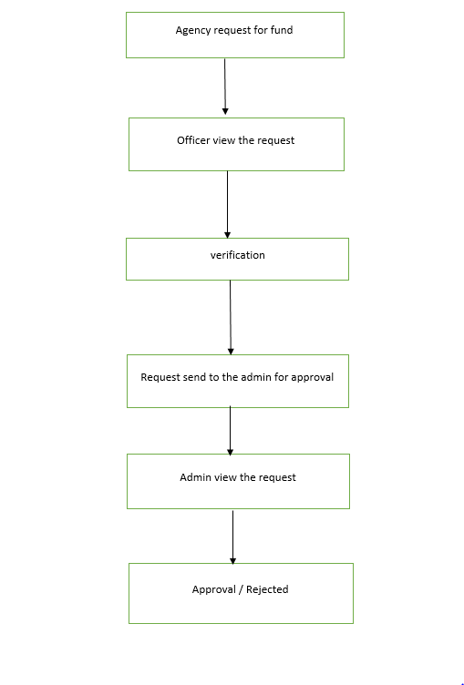
FLOW CHART

Slide 11
TOOLS ,FRAMEWORK OR PROGRAMMING LANGUAGE
Front End : html , CSS,
Back End : python , Mysql
GIT
https://github.com/Lakshmic2000/Main_project.git

Slide 12
RESEARCH PAPERS AND REFERENCE
[1] Government fund distribution and tracking system using blockchain technology
2020 JETIR September 2020, Volume 7, Issue 9
www.jetir.org (ISSN-2349-5162)
JETIR2009190 Journal of Emerging Technologies and Innovative Research (JETIR)
[2] Government fund distribution system using Blockchain
Vol. 10, Issue 5, May 2021
10.17148/IJARCCE.2021.105111
International Journal of Advanced Research in Computer and Communication Engineering

Slide 13
Thank you

